Slide 1
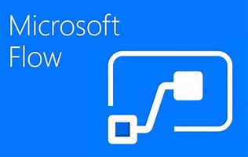
Flow for SharePoint
An Introduction
Scott Shearer
Office 365 Evangelist
Haystax technology

Slide 2
Who is Scott?
Microsoft Certified Trainer (MCT)
Microsoft Office 2016 Specialist Master
SharePoint Evangelist and Consultant for Haystax Technology
Based in Tysons Corner, VA
Done everything from System Administration to C# development to helpdesk
Former CPA
Former Certified Financial Planner (CFP) and stock broker
Past Certifications Held: MCSE, MCSD, MCDBA, MCT, CNE
Conference Speaker

Slide 3
Contact Info
@ScottJShearer
scott@O365Scott.com
O365Scott.blog
Youtube: “I Didn’t Know I Could Do That With Office 365!”

Slide 4


Our Sponsors

Slide 5
Agenda
Flow Overview
1
Flow Demo
2
Flow Pricing
3
Flow Administraion
4

Slide 6
What Version of SharePoint do I need?
SharePoint Online
On-premises SharePoint 2013 or 2016 farm using the On-Premises Data Gateway

Slide 7
Flow Overview
Automation/Workflow Tool
Not a SharePoint specific tool
Cloud Service
No “On Prem” installation
No desktop client is required
Key Concepts
Services and Connectors
Triggers
Actions
Browser based development environment

Slide 8
Services and Connectors
Flow uses Connectors to interact with Services
1
SharePoint is a Service accessed via the SharePoint Connector
Currently there are over 110 120+ ??? services
2
More coming all the time

Slide 9
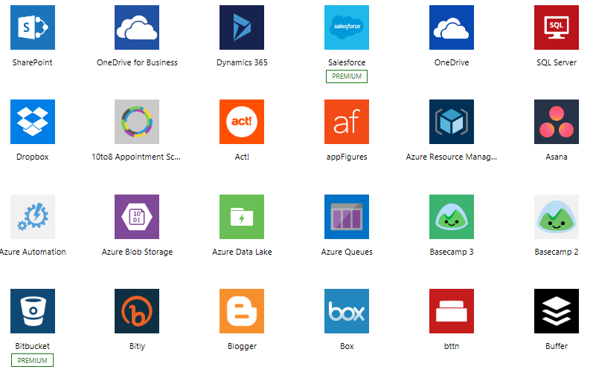
Sample Connectors

Slide 10
Triggers
An event that can be used to start a Flow
Every Service has different triggers

Slide 11
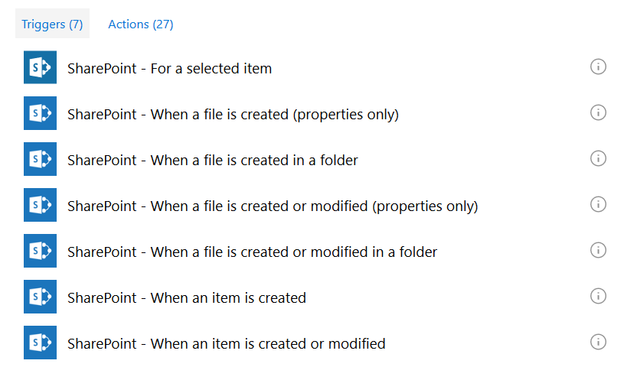
SharePoint Triggers

Slide 12
Actions
Work that is performed
Every Service has different Actions

Slide 13
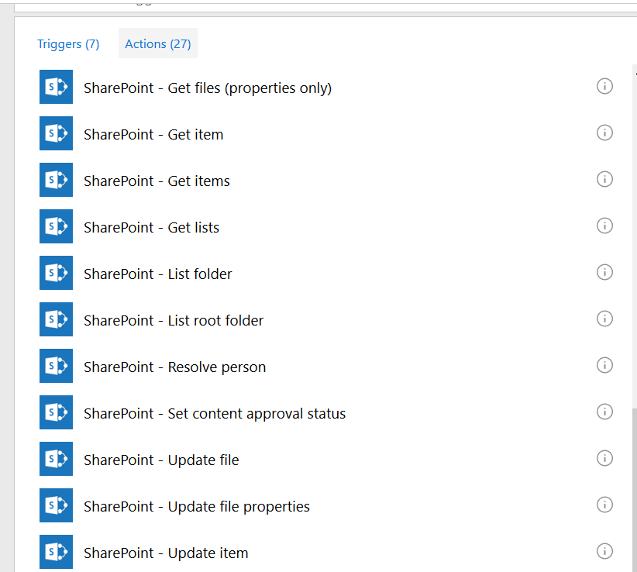
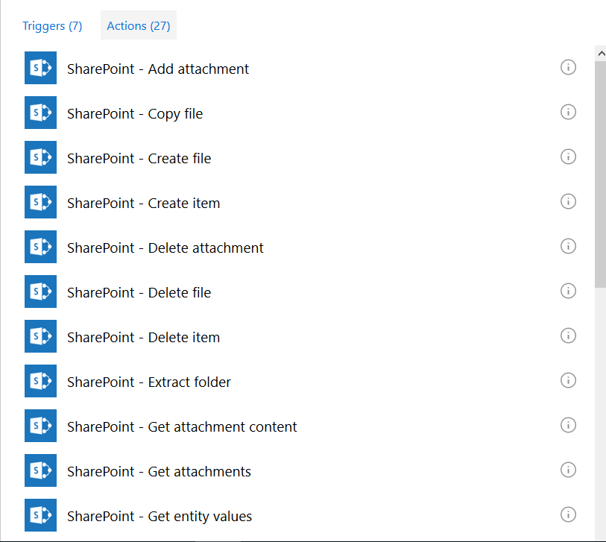
SharePoint Actions

Slide 14

Mobile App
iPhone and Android apps currently available
  Create and manage Flows
  Push notifications
  Button Apps

Slide 15
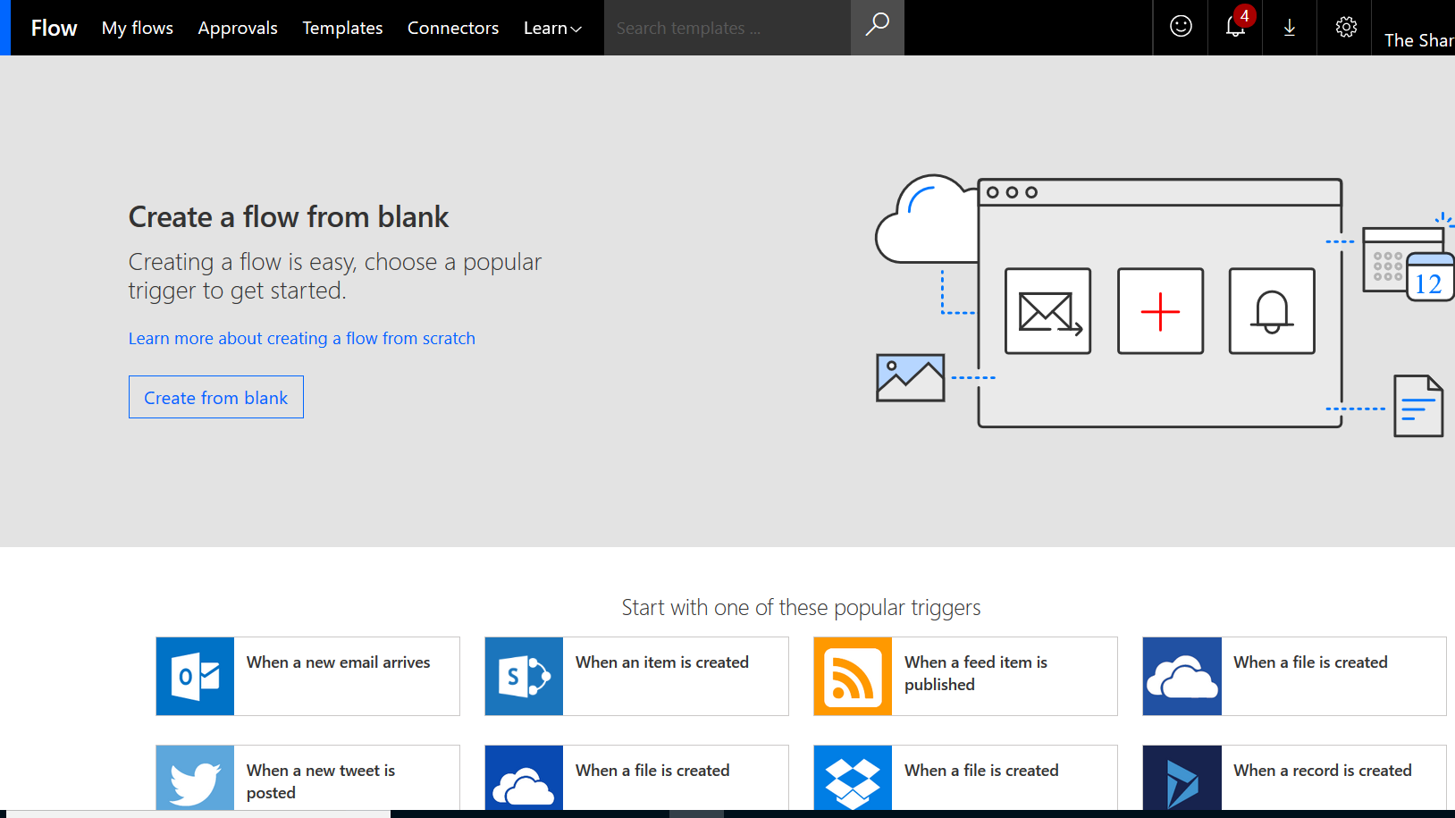
Creating Flows
Flows can be created from
  Templates
    Pre-Built Flows designed to perform a specific task
    Can be customized
  From Scratch

Slide 16
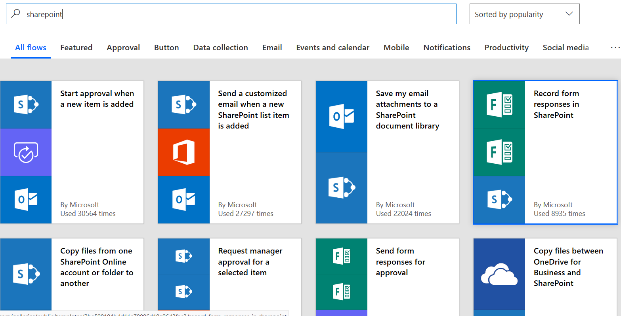
Sample SharePoint Templates
(there are lots more)

Slide 17
Demo
Build a Flow From a Template
Build Flows from Scratch

Slide 18
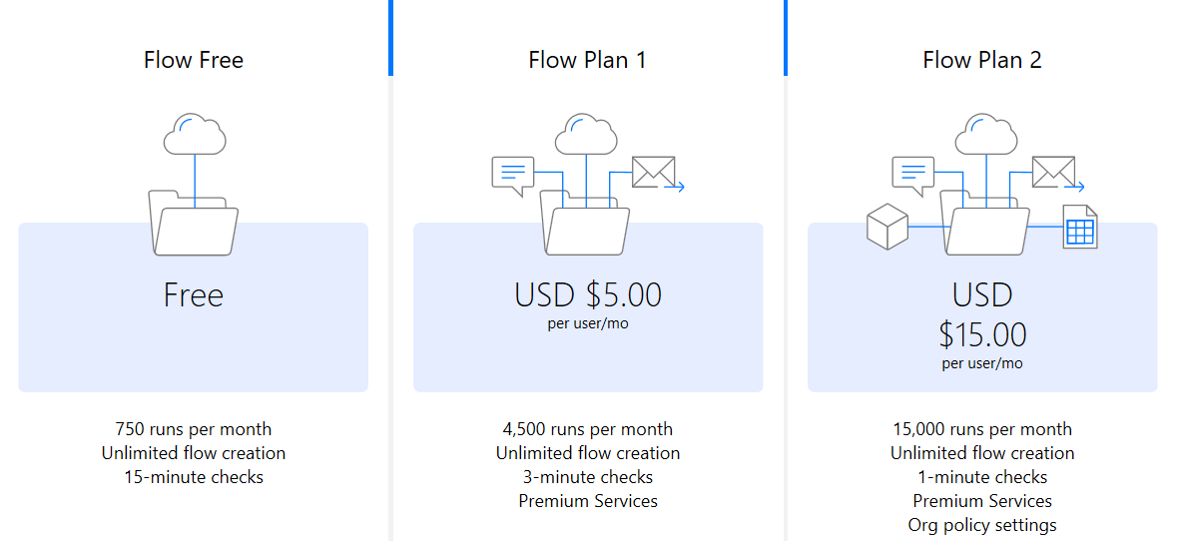
Plans and Pricing

Slide 19
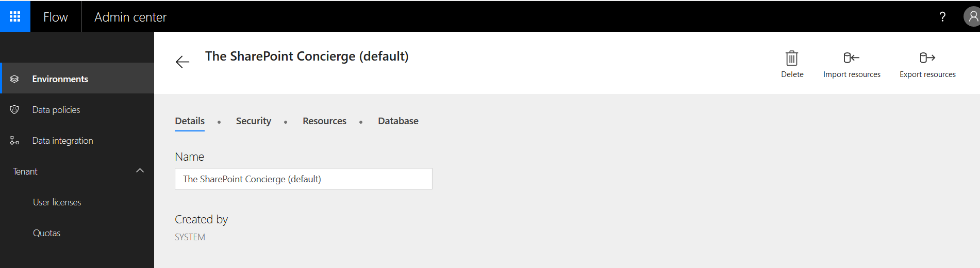
Flow Administration

Slide 20
Random Thoughts
Naming Convention?
Non-person accounts?
Governance?

Slide 21
So, what do I do now?
Start using Flow for the tasks that Flow can accomplish
There is no need to start converting Designer workflows to Flow

Slide 22
Resources
flow.microsoft.com
Documentation link
Community link
YouTube
Expressions
http://bit.ly/2svdQgc

Slide 23
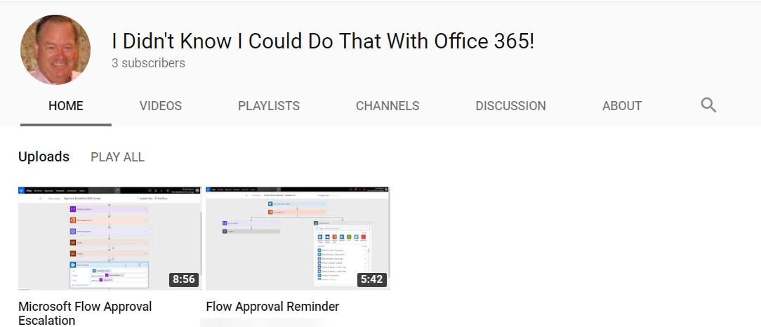
Contact Info
@ScottJShearer
scott@O365Scott.com
O365Scott.blog

Slide 24
Demo
Use Send Email template for custom list
  Run
  Change email by formatting date
    Parameter is ‘D’
Create from Scratch
  When email is received with attachments, create list item and add attachments
Reminder Flow
Approval

